Slide 1
CROP LINK
- Fasal Sena

Slide 2
Topic
Platform that connects local farmers to consumers to reduce food wastage while promoting sustainable consumption.

Slide 3
agenda
Digital marketplace connecting farmers directly with consumers to sell produce, reducing middlemen and food waste in distribution.
Transparency in farming practices and produce origin empowers consumers to make informed purchasing decisions.
Efficient logistics optimize transportation, minimizing environmental impact.
Surplus management features facilitate sale of excess or imperfect produce, reducing waste.
Consumer education resources promote sustainable food choices, fostering a more efficient food system.

Slide 4

What are the solutions?
Create a website that links the local farmer and consumer directly so that there is no middle man and there is less food waste as farmers can directly sell to consumers avoiding stores storage.

Slide 5

Brainstorming
Discussing the basic ideas of how to deliver the website and mapping the websites

Slide 6
Working of the website
The website functions a farmers and consumers aiming to combat food wastage while promoting sustainable consumption.
Upon landing on the main page visitors are greeted with informative content dealing various methods to reduce food wastage
Once user decides to engage further, they are prompted to login , where they can register as either Consumers or Farmers.
Once registered (as consumers) they encounter a range of options categorized by product types such as vegetable , Fruits etc.
Once registered (as farmers) they can upload options of product with their quantity and price , also they can add an image to it.

Slide 7

Creating a Website: Step-by-Step

Slide 8
Thank you
Fasal Sena

Slide 9
Selecting visual aids
Enhancing your presentation

Slide 10
Effective delivery techniques
This is a powerful tool in public speaking. It involves varying pitch, tone, and volume to convey emotion, emphasize points, and maintain interest.
Pitch variation
Tone inflection
Volume control
Effective body language enhances your message, making it more impactful and memorable.
Meaningful eye contact
Purposeful gestures
Maintain good posture
Control your expressions

Slide 11

Navigating Q&A sessions
Maintaining composure during the Q&A session is essential for projecting confidence and authority. Consider the following tips for staying composed:
Stay calm
Actively listen
Pause and reflect
Maintain eye contact
Know your material in advance
Anticipate common questions
Rehearse your responses

Slide 12
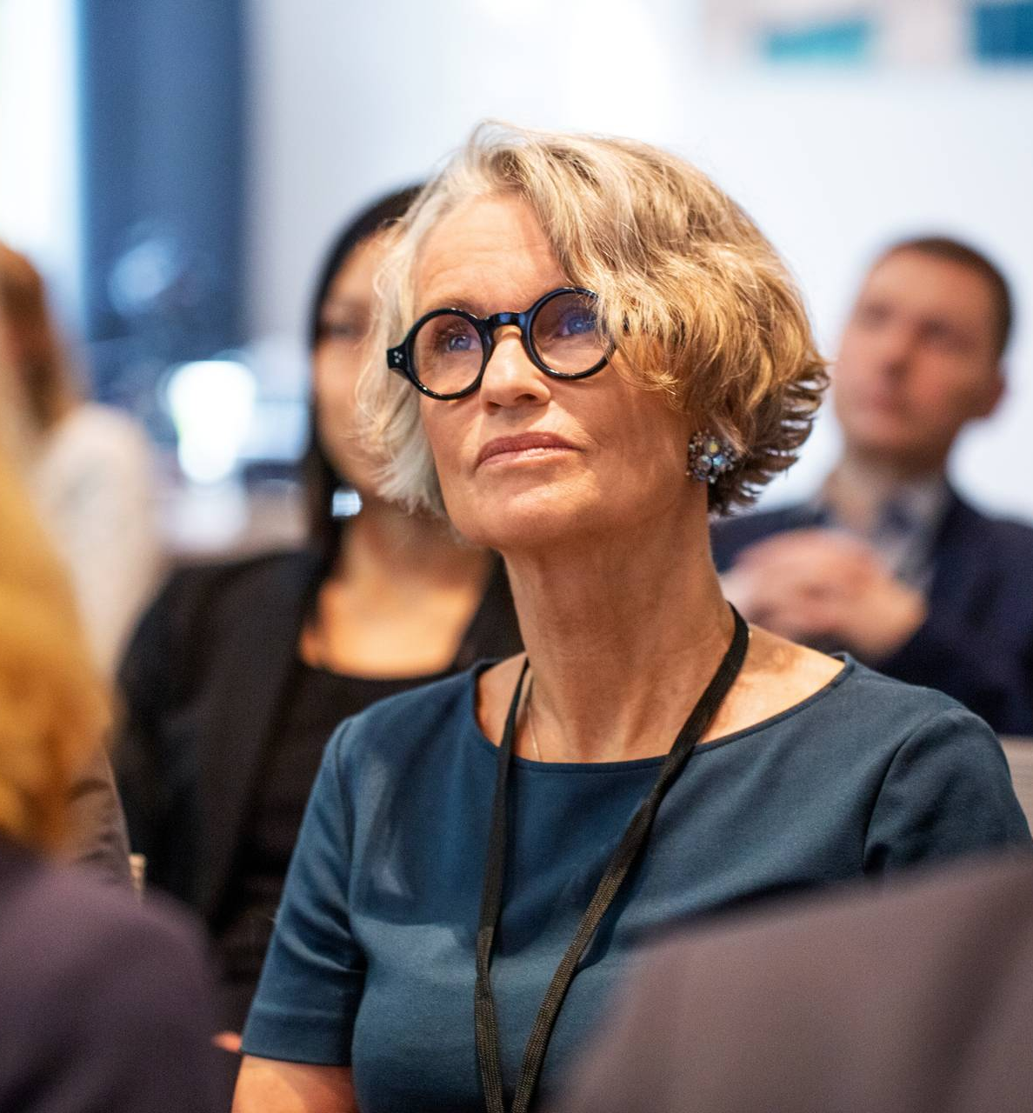
Speaking impact
Your ability to communicate effectively will leave a lasting impact on your audience
Effectively communicating involves not only delivering a message but also resonating with the experiences, values, and emotions of those listening

Slide 13
Dynamic delivery
Learn to infuse energy into your delivery to leave a lasting impression
One of the goals of effective communication is to motivate your audience
Metric | Measurement | Target | Actual
Audience attendance | # of attendees | 150 | 120
Engagement duration | Minutes | 60 | 75
Q&A interaction | # of questions | 10 | 15
Positive feedback | Percentage (%) | 90 | 95
Rate of information retention | Percentage (%) | 80 | 85

Slide 14
Final tips & takeaways
Consistent rehearsal
Strengthen your familiarity
Refine delivery style
Pacing, tone, and emphasis
Timing and transitions
Aim for seamless, professional delivery
Practice audience
Enlist colleagues to listen & provide feedback
Seek feedback
Reflect on performance
Explore new techniques
Set personal goals
Iterate and adapt

Slide 15
Speaking engagement metrics
Impact factor | Measurement | Target | Achieved
Audience interaction | Percentage (%) | 85 | 88
Knowledge retention | Percentage (%) | 75 | 80
Post-presentation surveys | Average rating | 4.2 | 4.5
Referral rate | Percentage (%) | 10 | 12
Collaboration opportunities | # of opportunities | 8 | 10

